Slide 1
Virtual Machines and Virtualization of Clusters and Data Centers

Slide 2
What is Virtualization?
The Software methods (including hypervisors)used to allow multiple virtual computing resources to run on a single hardware platform.
What is a VM?
A Software Virtualization of a Computer Hardware that executes program like a physical computer and can be interacted with like a physical computer.

Slide 3
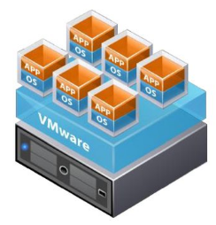
What is VM?
Allows to run Multiple Operating Systems as VMs on a single computer
A VM is a discrete set of files.
Main Files:
Configuration file
Virtual disk file
NVRAM settings file
Log file

Slide 4
Virtualization is a computer architecture technology by which multiple virtual machines (VMs) are multiplexed in the same hardware machine.

Slide 5
The purpose of a VM is to enhance resource sharing by many users and improve computer performance in terms of resource utilization and application flexibility.
Hardware resources (CPU, memory, I/O devices, etc.) or
software resources (operating system and software libraries) can be virtualized in various functional layers.

Slide 6
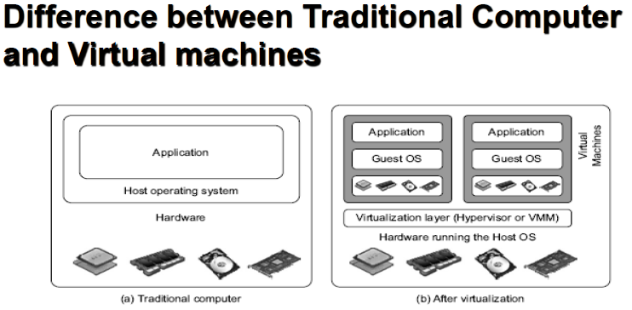
4.1) Virtual Machines

Slide 7
Virtual Machine, Guest Operating System, and VMM (Virtual Machine Monitor) :
VM-
A representation of a real machine using software that provides an operating environment that can run a guest OS
Guest OS-
An operating system running on a VM that would otherwise run on directly on a separate physical system.
VMM-
The Virtualization Layer is the middleware between the VM and the underlying Host platform , also called as Virtual Machine Monitor or VMM.

Slide 8
Benefit of Virtualization
Let us assume a system having Multicore Processor with 20 cores
Without Virtualization-
20 cores dedicated to one application
With virtualization =
3 cores to Application A1
3 cores to Application A2
4 cores Application A3
Remaining 10 cores for Host Machine
Resources are shared
Effective Utilization of Resources

Slide 9
Virtualization=Software defined technology
Software defined compute
Software defined networking
Software defined storage

Slide 10
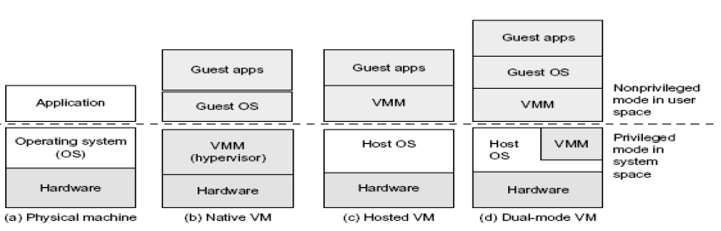
Virtual Machine Architecture
Three VM Architecture (b),(c),(d) compared with the traditional physical machine in (a)

Slide 11
(b)- This Hypervisor handles the bare hardware(CPU, memory, I/O) directly, hence called as Bare Metal Hypervisor or Native VM
(c)-VMM runs in Non-priviledged mode. The Host OS needs not to be modified.
(d)-VM implemented in Dual Mode. Part of the VMM runs at the user level and another part runs at the supervisor level. Host OS has to be modified to some extent.

Slide 12
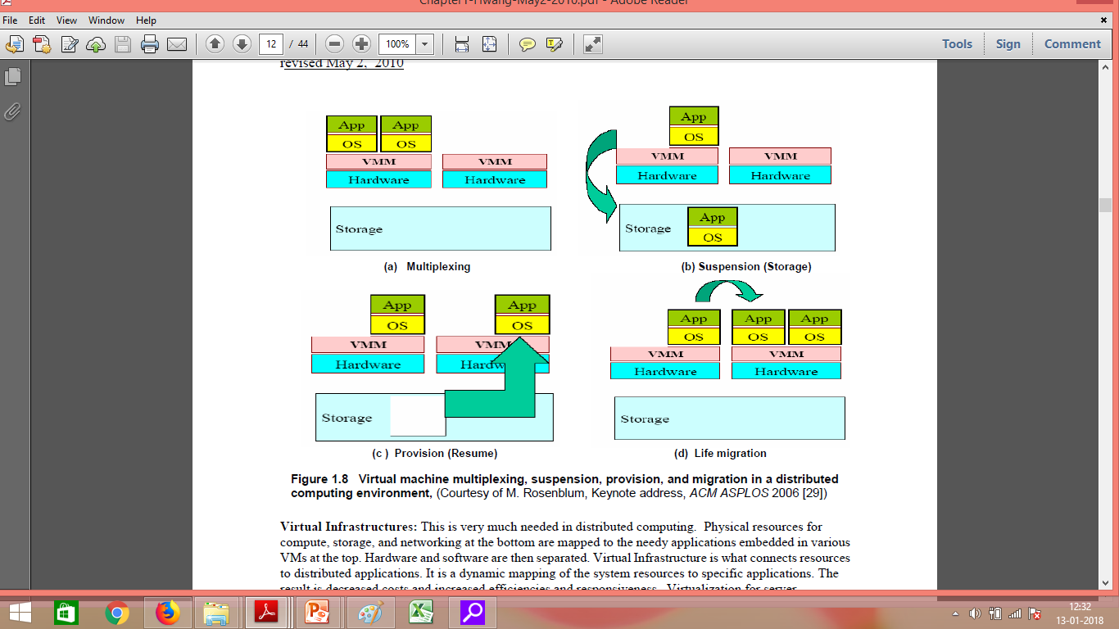
Primitive Operations in Virtual Machines:

Slide 13
Primitive Operations in Virtual Machines:
VMs can be multiplexed b/w hardware m/c
A VM can be suspended and stored in stable storage
A suspended VM can be resumed or provisioned to a new hardware platform.
You suspend a virtual machine when you want to save its current state.
When you resume the virtual machine, applications that were running before the virtual machine was suspended resume in their running state and their content is unchanged.
A VM can be migrated from one hardware platform to another.

Slide 14
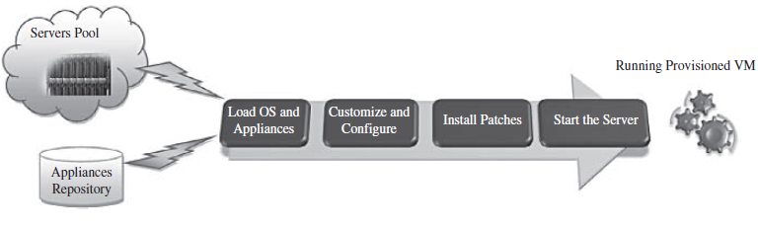
Provisioning VM
The steps of provisioning a Virtual Machine are:
Firstly, you need to select a server from a pool of available servers along with appropriate OS template you need to provision the VM
Secondly, you need to load the appropriate software(OS you selected in the previous step, device drivers, middleware and the needed applications for the service required).

Slide 15
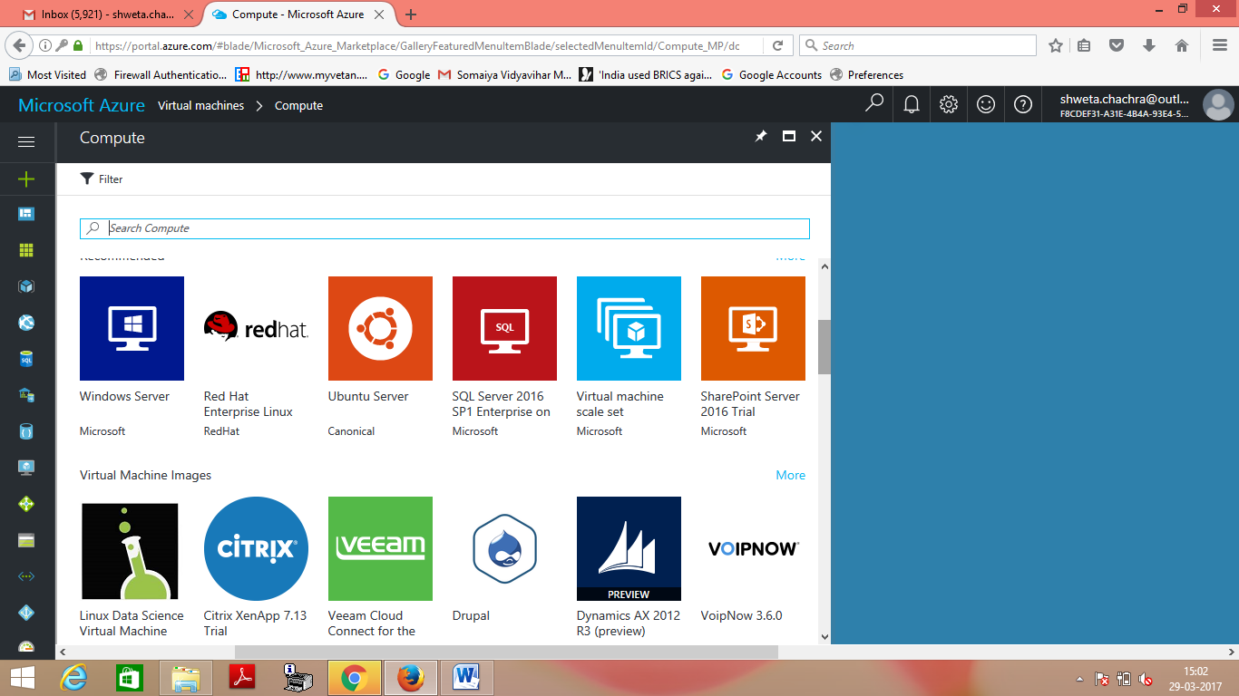
Eg-Selecting a server followed by OS in Microsoft Azure

Slide 16
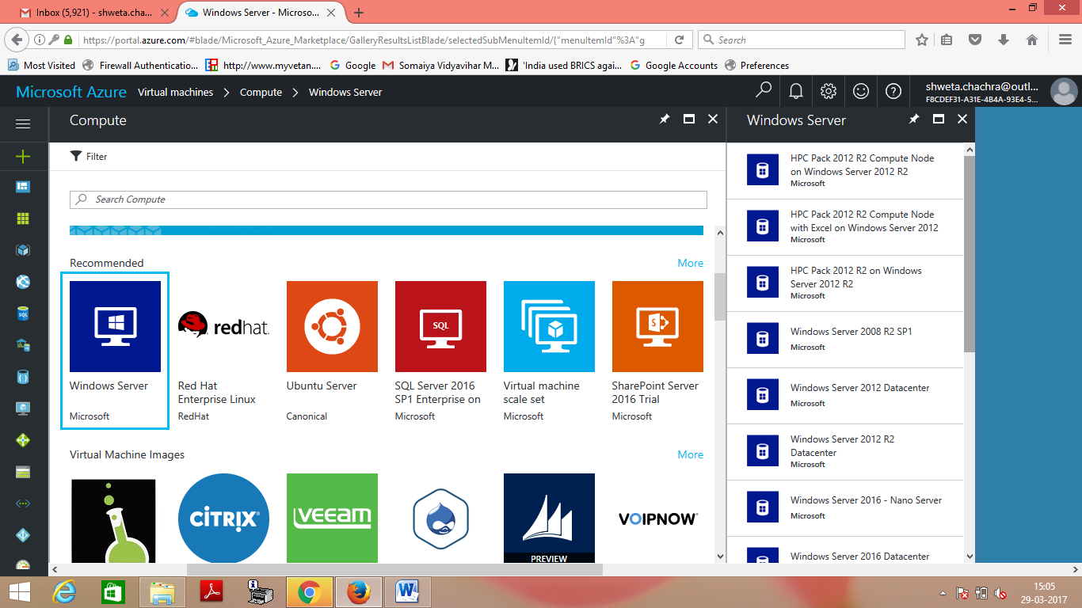
Eg-Selecting a server followed by OS in Microsoft Azure

Slide 17
Provisioning VM
Thirdly, you need to customize and configure the M/c(eg:IP address, Gateway) to configure an associated n/w and storage resources.
Finally, the VM is ready to start with its newly loaded software.

Slide 18
Live Migration
Hot Migration
Real-Time Migration
Movement of a virtual m/c from one physical host to another while being powered on.

Slide 19
Live Migration
When it is properly carried out,
this process takes place without any noticeable effect from the end user’s point of view(a matter of milliseconds).
Can also be used for load balancing
work is shared among computers
to optimize the utilization of available CPU Resources.

Slide 20
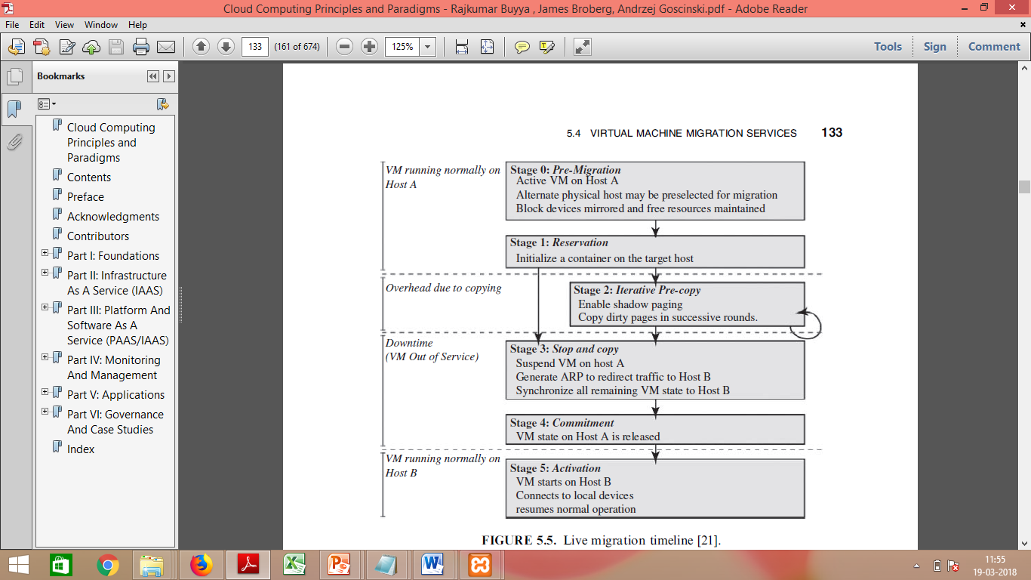
Live Migration

Slide 21
Live Migration
Stage 0:Pre Migration:
An Active VM exists on the physical host A.
Alternate physical host may be selected for migration

Slide 22
Live Migration
Stage 1:Reservation:
A request is issued to migrate an OS from host A to host B
A precondition is that the necessary resources exist on B and on a VM container of that size

Slide 23
Live Migration
Stage 2:Iterative precopy:
During the first iteration,
all memory pages are transferred from A to B.
Subsequent iterations
copy only those memory pages dirtied during the previous transfer phase.

Slide 24
Live Migration
Stage 3: Stop and Copy:
Running OS instance at A is suspended
its network traffic is redirected to B.
CPU state and any remaining inconsistent memory pages are then transferred.

Slide 25
Live Migration
Stage 3: Stop and Copy:
At the end of this stage, there is
A consistent suspended copy of the VM at both A and B.
The copy at A is considered primary
Resumed in case of failure.

Slide 26
Live Migration
Stage 4:Commitment:
Host B indicates to A that it has successfully received a consistent OS image.
Host A acknowledges this message as a commitment of the migration transaction.
Host A may now discard the original VM
Host B becomes the primary host.

Slide 27
Live Migration
Stage 5:Activation:
The migrated VM on B is now activated.
Post Migration code runs to
reattach the device drivers to the new m/c and
advertise moved IP addresses.

Slide 28
Live Migration
Atleast One host has a consistent VM image at all times during migration.

Slide 29
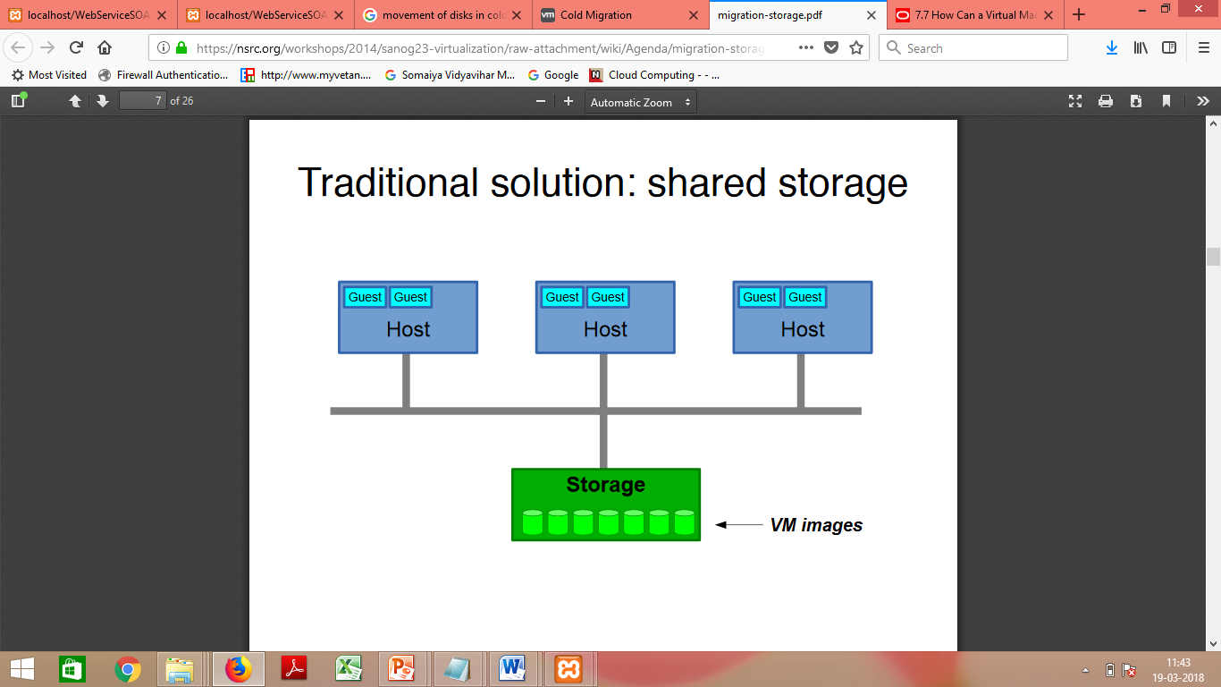
Regular/Cold Migration
Cold migration is the migration of a powered-off virtual machine.
With cold migration, you have the option of moving the associated disks from one data store to another.
In Cold Migration, The virtual machines are not required to be on a shared storage.

Slide 30
Regular/Cold Migration
The two main differences b/w live migration and cold migration are:
Live migration needs a shared storage for virtual machines in the server’s pool, but cold migration does not; also,
In live migration for a virtual machine between two hosts, there would be certain CPU compatibility checks to be applied; while in cold migration these checks do not apply.

Slide 31
Regular/Cold Migration
The cold migration process is simple to implement ,can be summarized as follows:
The configuration files, including the NVRAM file (BIOS settings), log files, as well as the disks of the virtual machine, are moved from the source host to the destination host’s associated storage area.
The virtual machine is registered with the new host.
After the migration is completed, the old version of the virtual machine is deleted from the source host.

Slide 32
Applications of Migration
Load balancing:
Move VMs to a less busy host
Make use of newly-added capacity
Recovery from host failure
Restart VM on a different host
Maintenance
Planned Shutdown:
Move VMs off a host before it is shut down

Slide 33
Levels of Virtualization Implementation
The main function of the software layer for virtualization is to virtualize the physical hardware of a host machine into virtual resources to be used by the VMs, exclusively. This can be implemented at various operational levels,
The virtualization software creates the abstraction of VMs by interposing a virtualization layer at various levels of a computer system.

Slide 34
Levels of Virtualization Implementation
Common virtualization layers include the
instruction set architecture (ISA) level
hardware level
operating system level
library support level
application level

Slide 35
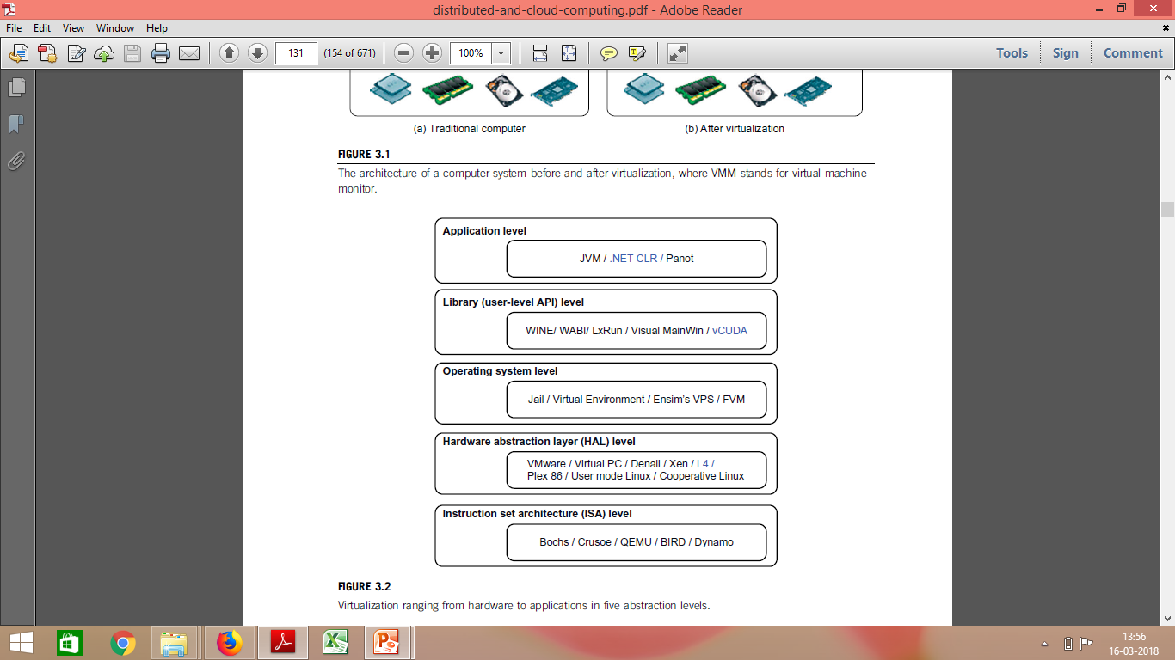
Levels of Virtualization Implementation

Slide 36
Instruction Set Architecture Level

Slide 37
What is an Instruction Set?
The instruction set provides commands to the processor, to tell it what it needs to do.

Slide 38
What is an Instruction Set?
The instruction set provides commands to the processor, to tell it what it needs to do.
The instruction set consists of
addressing modes,
operation,
native data types,
registers,
memory architecture,
interrupt, and
exception handling, and
external I/O.

Slide 39
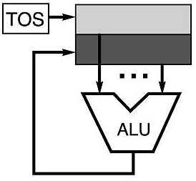
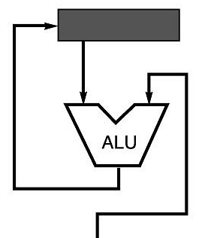
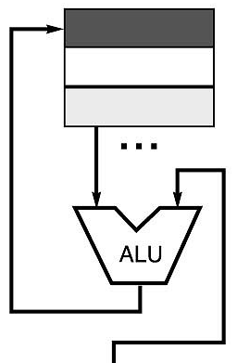
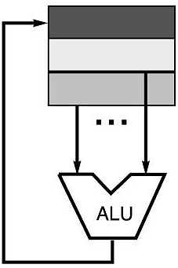
Code Sequence C = A + B for Four Instruction Sets
Stack | Accumulator | Register (register-memory) | Register (load-store)
Push A Push B Add Pop C | Load A Add B Store C | Load R1, A Add R1, B Store C, R1 | Load R1,A Load R2, B Add R3, R1, R2 Store C, R3
memory
memory
acc = acc + mem[C]
R1 = R1 + mem[C]
R3 = R1 + R2

Slide 40
What is an Instruction Set?
Example-
x86 instruction set, which is common to find on computers today.
Different computer processors can use almost the same instruction set while still having very different internal design.
Both the Intel Pentium and AMD Athlon processors use nearly the same x86 instruction set.

Slide 41
Instruction Set Architecture Level
Virtualization –
Transforming the physical architecture of the system’s instruction set completely into software.

Slide 42
Instruction Set Architecture Level
The guest systems issue instructions for the emulator to process and execute.
The instructions are received by the emulator, which transforms them into a native instruction set.
The native instructions are run on the host m/c’s hardware.
The instructions include both the processor-oriented instructions and the I/O specific ones.

Slide 43
For example,
MIPS binary code can run on an x86-based host machine with the help of ISA emulation.
With this approach, it is possible to run a large amount of legacy binary code written for various processors on any given new hardware host machine

Slide 44
MIPS (Microprocessor without Interlocked Pipelined Stages) is a family of reduced instruction set computer (RISC) instruction set architectures (ISA) developed by MIPS Technologies, based in the United States.
There are multiple versions of MIPS: including MIPS I, II, III, IV, and V; as well as five releases of MIPS32/64 (for 32- and 64-bit implementations, respectively).

Slide 45
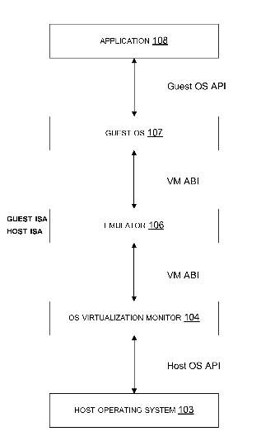
Instruction Set Architecture Level
Receiving a request to execute an application.
The application can include first application instructions from a guest instruction set architecture.
Loading an emulator
The emulator can translate the first application instructions into second application instructions from a host instruction set architecture.
Running the application by executing the second application instructions.

Slide 46
Instruction Set Architecture Level
The basic emulation method is through code interpretation.
An interpreter program interprets the source instructions to target instructions one by one.
One source instruction may require tens or hundreds of native target instructions to perform its function.
Obviously, this process is relatively slow.

Slide 47
Instruction Set Architecture Level
Instruction set emulation requires binary translation and optimization.
A virtual instruction set architecture (V-ISA) thus requires adding a processor-specific software translation layer to the compiler

Slide 48
Instruction Set Architecture Level
Advantage:
Enables the host system to adjust to a change in the architecture of the guest system, if accomplishing a task can be possible through the instructions that are available with the host system.

Slide 49
Instruction Set Architecture Level
Advantage:
The infrastructure provided by the virtualization of this kind can be used for creating VMs on a platform.
For eg- x86 on any platform such a x86,Sparc or Alpha etc.
With this approach, it is possible to run a large amount of legacy binary code written for various processors on any given new hardware host machine.

Slide 50
Instruction Set Architecture Level
Disadvantage:
The instructions need to be interpreted before being executed.
An interpreter program interprets the source instructions to target instructions one by one.
Therefore the system with the virtualization at ISA level shows a poor performance.
One source instruction may require tens or hundreds of native target instructions to perform its function. Obviously, this process is relatively slow.

Slide 51
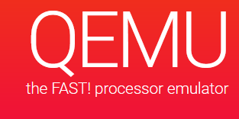
Qemu
QEMU is a generic and open source machine emulator and virtualizer.
Run operating systems for any machine, on any supported architecture

Slide 52
Hardware Abstraction Level WHAT?
On the one hand, this approach generates a virtual hardware environment for a VM.
On the other hand, the process manages the underlying hardware through virtualization

Slide 53
Hardware Abstraction Level WHAT?
The idea is to virtualize a computer’s resources, such as its:
Processors
memory, and
I/O devices.
The intention is to upgrade the
hardware utilization rate by multiple users concurrently.

Slide 54
Virtualization at Hardware Abstraction level: WHAT?
Virtualization is performed right
“on top of the bare hardware.”
It generates virtual hardware environments for VMs, and manages the underlying hardware through virtualization. Typical systems: VMware, Virtual PC, Denali, Xen

Slide 55
Virtualization at Hardware Abstraction level: WHAT?
Example-
The Xen hypervisor has been applied to virtualize x86-based machines to run Linux or other guest OS applications.

Slide 56
Hardware Abstraction Level(Privileged Instructions) WHAT?
What are Privileged Instructions?
The Instructions that can run only in Kernel Mode are called Privileged Instructions
Privileged instructions by VMs
Execution of privileged instructions need full attention of CPU.
If not managed properly by the VMM, will raise an exception resulting into system crash.
Advantages:-
Trapping and forwarding the privileged instructions to VMM helps in managing a system properly, thereby
avoiding various risks and
keeping individual virtual m/cs isolated.

Slide 57
Hardware Abstraction Level(Privileged Instructions) HOW?
Hardware Level virtualization needs
trapping the execution of privileged instructions by the virtual m/c,
which must pass these instructions to the VMM for being handled properly

Slide 58
Hardware Abstraction Level(Privileged Instructions) HOW?
This is required because of the possible existence of multiple virtual machines,
each having its own OS that might issue separate privileged instructions.

Slide 59
Virtualization at Hardware Abstraction level :
It supports multiple OSs and applications to be run simultaneously which require
no system reboot or dual-boot setup.
It gives the appearance of
multiple separate m/cs each of which can be used as a normal system.
The degree of isolation is high, whereas
implementation is less risky and maintenance is easy.

Slide 60
Virtualization at Hardware Abstraction level:
However, this technique permits you to have access to a raw computer
which requires a lot of time to be spent in the installation and administration of the virtual system
before you can think of testing or running applications.
In case the physical and virtual Oss are the same,
It results in duplication of your efforts, which should be avoided for an efficient use of the system.

Slide 61
Hardware Abstraction Level
Advantage: has higher performance and good application isolation
Shortcoming & limitation: very expensive to implement (complexity)

Slide 62
Virtualization at Operating System level:
To overcome the issues of redundancy and time consumption
we implement virtualization at a higher level, i.e. virtualization at the level of the OS.
In case the physical and virtual Oss are the same,
It results in duplication of your efforts, which should be avoided for an efficient use of the system.

Slide 63
Virtualization at Operating System level:
It is an “abstraction layer between traditional OS and user applications.”

Slide 64
Virtualization at Operating System level:
Typical systems: Jail / Virtual Environment / Ensim's VPS / FVM

Slide 65
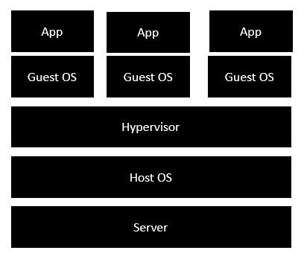
Traditional Virtualization
•Server is the physical server that is used to host multiple virtual machines.
•Host OS is the base machine such as Linux or Windows.
•Hypervisor is either VMWare or Windows Hyper V that is used to host virtual machines.
•One would then install multiple operating systems as virtual machines on top of the existing hypervisor as Guest OS.
•One would then host your applications on top of each Guest OS.

Slide 66
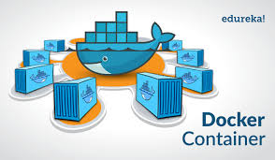
Dockers
Dockers containers are analogous to physical containers that you can use to store, package, and transport goods.
But instead of tangible goods, they’re containers for software applications.

Slide 67
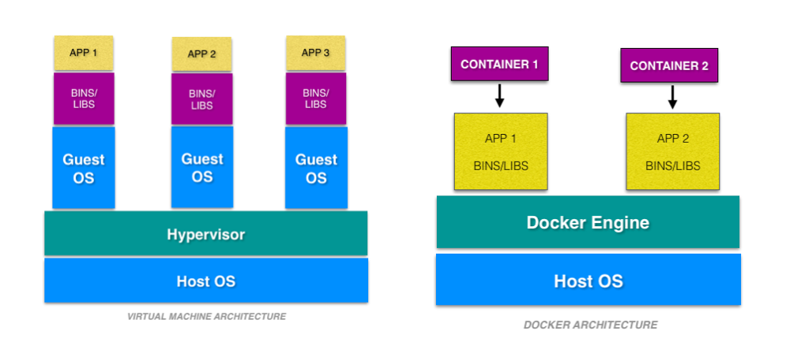
Dockers
A container is an environment that runs an application that is not dependent on the operating system.
A docker container is a portable unit of software—
that has the application
along with the associated dependency and configuration.

Slide 68
What is a Container?
The kernel of the host operating system
serves the needs of running different functions of an app, separated into containers.

Slide 69
What is a Container?
Each container runs isolated tasks.
It cannot harm the host machine nor
come in conflict with other apps running in separate containers.

Slide 70
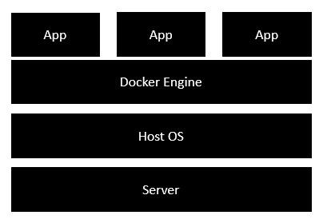
Docker – Architecture
•Docker engine-
is used to virtualize the guest operating system which earlier used to run in virtual machines
•All of the Apps now run as Docker containers.

Slide 71
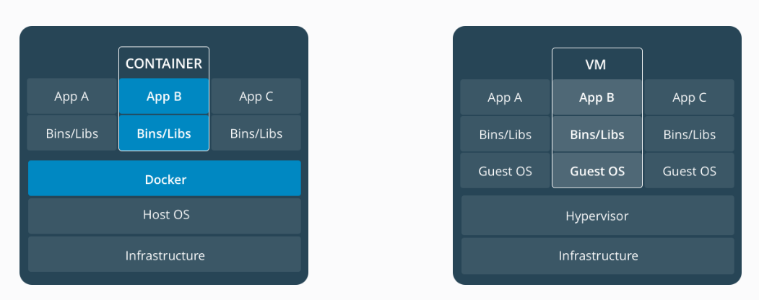
Containers vs Virtual Machines
Container
VM

Slide 73
Virtual Machines and Containers
Virtual machines run guest operating systems - the OS layer in each box.
Resulting disk image and application state is
an entanglement of OS settings,
system-installed dependencies,
OS security patches

Slide 74
Virtual Machines and Containers
•Containers can share a single kernel, and the only information that needs to be in a container image is the executable and its package dependencies, which never need to be installed on the host system.
•These processes run like native processes, and can be managed individually
•Because they contain all their dependencies, there is no configuration entanglement;
A containerized app “runs anywhere”

Slide 75
Operating System Level
The containers behave like real servers.
OS-level virtualization is commonly used in creating virtual hosting environments to
allocate hardware resources among a large number of mutually distrusting users.

Slide 76
Library Support Level
Most applications use APIs exported by user-level libraries rather than using lengthy system calls by the OS.

Slide 77
Library Support Level
APIS are used to
save the users from the minute details entailed with programming related to the OS and
enable programmers to write programs easily.
Most systems provide well-documented APIs,
This is taken as another candidate for virtualization.

Slide 78
Library level virtualization
Also called
User-level Application Binary Interface (ABI) or
API emulation.

Slide 79
Library level virtualization
Create execution environments for running alien programs on a platform
rather than creating a VM to run the entire operating system.
It is done by API call interception and remapping.
Typical systems: Wine, WAB, LxRun , VisualMainWin

Slide 80
Library Support Level
Virtualization with library interfaces is possible by controlling the communication link between applications and the rest of a system through API hooks.
The software tool WINE has implemented this approach to support Windows applications on top of UNIX hosts.
https://www.winehq.org/

Slide 81
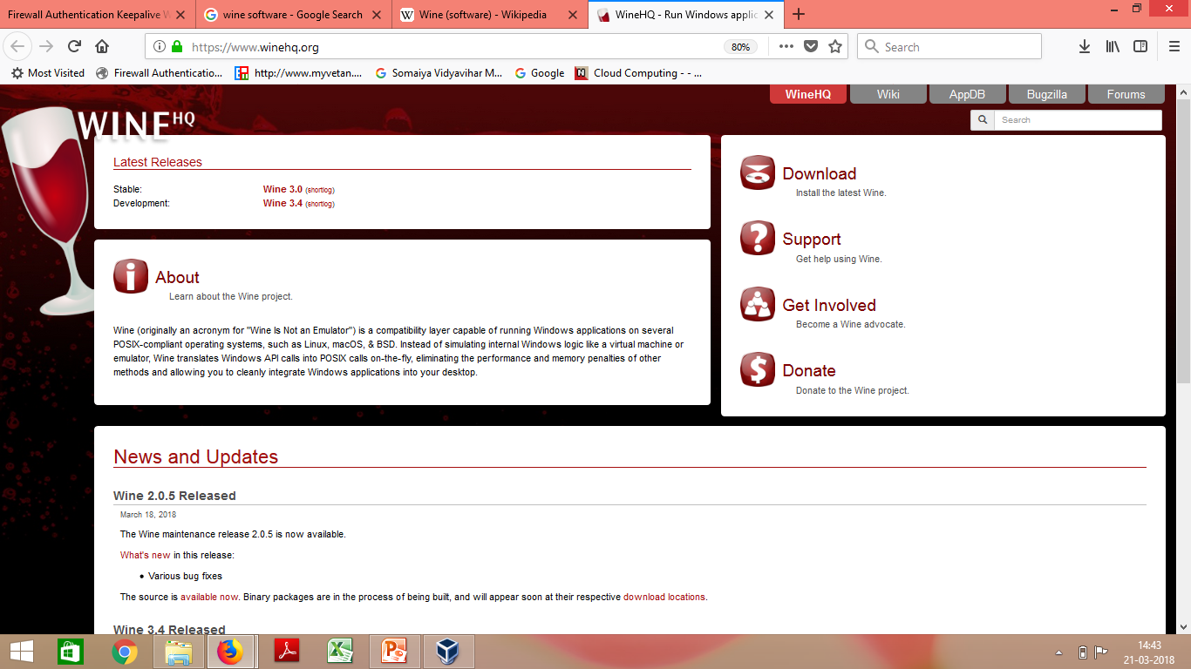
WINE
https://www.winehq.org/
Screenshot:

Slide 82
WINE
Wine (recursive backronym for Wine Is Not an Emulator)
A free and open-source compatibility layer that aims to allow
computer programs developed for Microsoft Windows
to run on Unix-like operating systems.

Slide 83
WINE
Instead of simulating internal Windows logic like a virtual machine,
Wine translates Windows API calls into POSIX((Portable Operating System Interface) calls on-the-fly,
eliminating the performance and memory penalties of other methods and
allowing you to cleanly integrate Windows applications into your desktop.

Slide 84
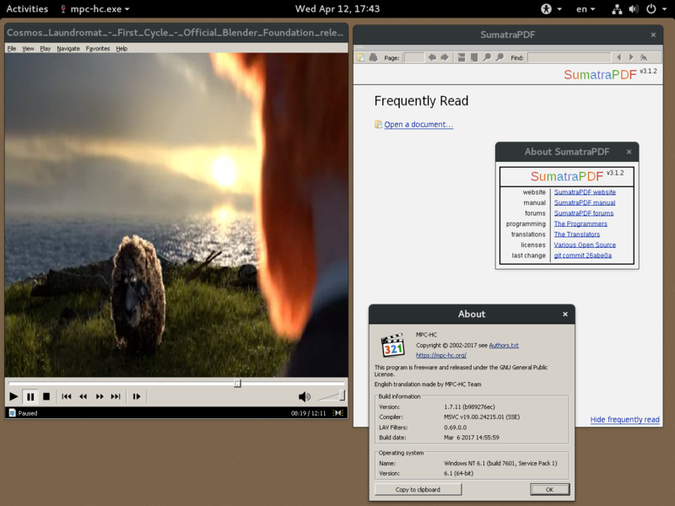
WINE v2.0.5 running Sumatra PDF and Media Player Classic on Fedora

Slide 85
Library Support level:
Another example is the vCUDA which allows applications executing within VMs to leverage GPU hardware acceleration.

Slide 86
Library Support level:
Advantage: It has very low implementation effort
Shortcoming & limitation: poor application flexibility and isolation

Slide 87
User-Application Level
Application level virtualization
Virtualizes an application as a VM.
On a traditional OS, an application often runs as a process.
Also known as Process-level virtualization.

Slide 88
User-Application level:
High level language (HLL) VMs
The virtualization layer sits as
an application program on top of an operating system and
exports an abstraction of a VM that can run programs which are written and compiled to that particular abstract machine definition.
Any program written in the HLL and compiled for this VM will run on it.

Slide 89
User-Application level:
The Microsoft .NET CLR and Java Virtual Machine (JVM) are two good examples of this class of VM.
The arrival of Java Virtual Machine(JVM) brought a new dimension to virtualization, which is known as application level virtualization.

Slide 90
JVM
A Java virtual machine (JVM) is a virtual machine that enables a computer to run Java programs as well as programs written in other languages but compiled to Java bytecode.

Slide 91
Revisiting facts about Java
The Compiler of java called as javac converts source code into a Intermediate file known as Bytecode file.
The Bytecode file is platform independent
The Interpreter of java (java) converts Bytecode into the specific OS compatible machine code . This code will vary according to OS.
Java interpreter:
The Java interpreter decodes and executes bytecode for the Java virtual machine.
The Java interpreter is actually a part of JVM.
Virtual machine is not just executing the bytecodes, it has lot of tasks to do. That full-fledged environment is referred to as a JVM.

Slide 92
JVM
The Java Virtual Machine is responsible for interpreting Java byte code and translating this into actions or Operating System calls.
For example, a request to establish a socket connection to a remote machine will involve an Operating System call.
Different Operating Systems handle sockets in different ways - but the programmer doesn't need to worry about such details.

Slide 93
Stack based VMs
Both JVM and CLI are stack based VMs.
Based on Execution stack that is used to perform operations.

Slide 94
Stack based VMs
The byte code generated by compilers for these architectures
contains a set of instructions that load operand on the stack, perform some operations with them and put the result on the stack.

Slide 95
Register based VMs
An alternative based on registers.
Example- Parrot, A programming Language VM originally designed to support execution of PERL and then generalized to host the execution of dynamic languages.

Slide 96
User-Application Level
This type of VM has become popular with the Java programming language, which is implemented using the Java virtual machine.
Other examples include the .NET Framework, which runs on a VM called the Common Language Runtime.

Slide 97
Application virtual machine
A process VM,
also called an application virtual machine, or
Managed Runtime Environment (MRE),
runs as a normal application inside a host OS and supports a single process.
It is created when that process is started and destroyed when it exits.
Its purpose is to provide a platform-independent programming environment and allows a program to execute in the same way on any platform.

Slide 98
User-Application Level
Other forms of application-level virtualization are:
application isolation
application streaming.
The process involves wrapping the application in a layer that is isolated from the host OS and other applications.
The result is an application that is much easier to distribute and remove from user workstations.

Slide 99
What is LANDesk?
An example of application virtualization.

Slide 100
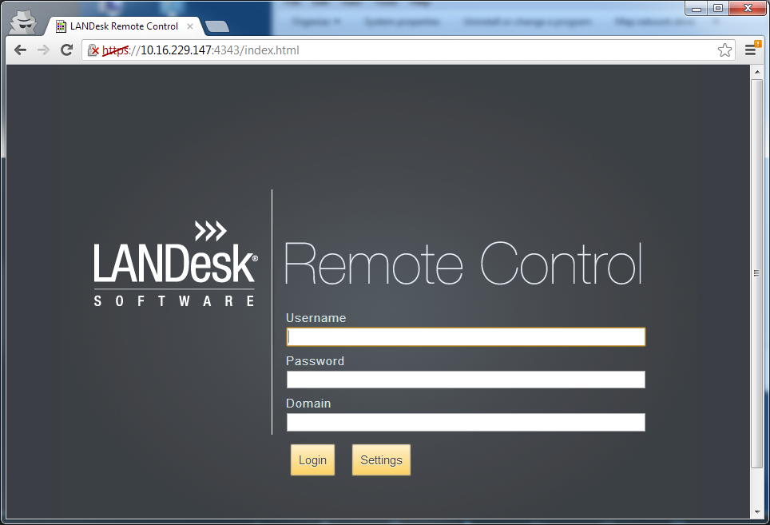
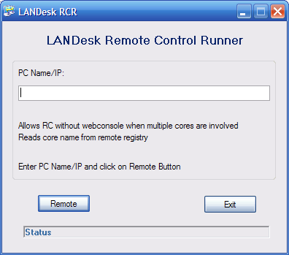
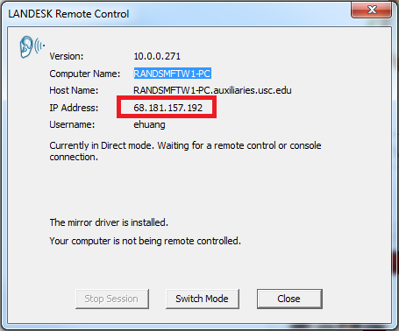
What is LANDesk?

Slide 101
What is LANDesk?
LANDESK's Remote Control capabilities allow information technology departments to minimize downtime by
Fixing computer errors and updating systems from a remote location.
LANDesk is an asset management software system used to
remotely inventory and manage desktop computers.
Reports on installed software and hardware, allow remote assistance, and install operating system security patches.

Slide 102
User-Application Level
Advantage: has the best application isolation
Shortcoming & limitation: low performance, low application flexibility and high implementation complexity.

Slide 103
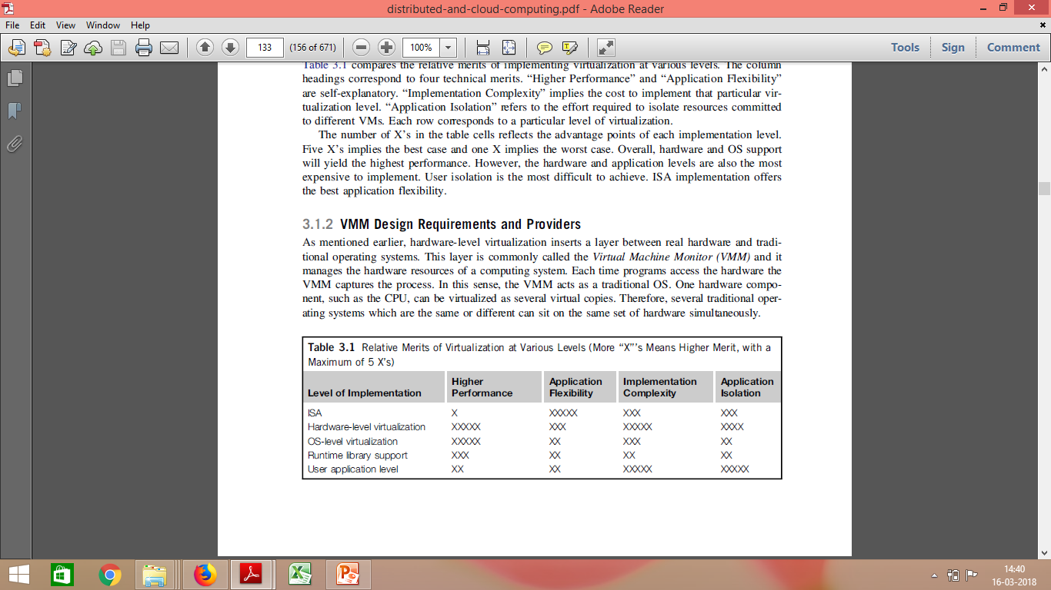
Relative Merits of Different Approaches
The number of X’s in the table cells reflects the advantage points of each implementation level.
Five X’s implies the best case and one X implies the worst case.

Slide 104
Relative Merits of Different Approaches
Overall, hardware and OS support will yield the highest performance.
However, the hardware and application levels are also the most expensive to implement.
User isolation is the most difficult to achieve.
ISA implementation offers the best application flexibility.

Slide 105
Virtualization Design Requirements
Equivalence Requirement
Efficiency Requirement
Resource Control requirement

Slide 106
Virtualization Design Requirements
Equivalence Requirement
A m/c that is developed through virtualization must have a logical equivalence with the real m/cs :
Needs to match the capabilities of the physical system in its computational performance.
How??

Slide 107
Virtualization Design Requirements
Equivalence Requirement
A m/c that is developed through virtualization must have a logical equivalence with the real m/cs :
Needs to match the capabilities of the physical system in its computational performance.
To execute all the applications and programs that are designed to execute on the real m/cs.

Slide 108
Virtualization Design Requirements
Efficiency Requirement
While taking the route of Virtualization,
the virtual m/c must be as efficient in its performance as a real system.
Virtualization is primarily done with a purpose of getting efficient software
without the physical hardware.

Slide 109
Virtualization Design Requirements
Resource Control requirement
A typical computer system is a combination of various resources, including processors, memory, and I/O devices.
All these resources must be managed and controlled effectively by the VMM.
The VMM must be in a state of enforcing isolation between the virtualized systems.

Slide 110
VIRTUALIZATION STRUCTURES/TOOLS AND MECHANISMS Hypervisor
Hypervisor and Xen Architecture
Binary Translation with Full Virtualization
Para-Virtualization with Compiler Support

Slide 111
VIRTUALIZATION STRUCTURES/TOOLS AND MECHANISMS Hypervisor
The hypervisor supports hardware-level virtualization on bare metal devices like CPU, memory, disk and network interfaces.

Slide 112
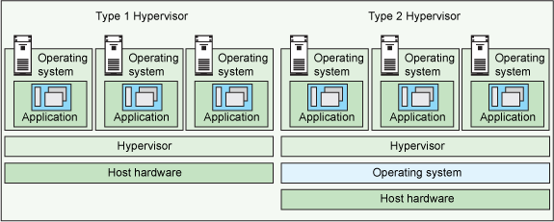
Hypervisors
There are two types of hypervisors:
Type 1 hypervisor:
hypervisors run directly on the system hardware – A “bare metal” embedded hypervisor,
Type 2 hypervisor:
hypervisors run on a host operating system that provides virtualization services, such as I/O device support and memory management.

Slide 113
Hypervisors
A hypervisor is a hardware virtualization technique allowing multiple operating systems, called guests to run on a host machine.
This is also called the Virtual Machine Monitor (VMM).

Slide 114
Hypervisors
Essentially, a hypervisor must be able to convert physical devices into virtual resources dedicated for the deployed VM to use

Slide 115
Type 1 Hypervisors
Type 1 hypervisor or the bare metal hypervisor
Sits on the bare metal computer hardware like the CPU, memory, etc.
All the guest operating systems are a layer above the hypervisor.
So the hypervisor is the first layer over the hardware.
The original CP/CMS hypervisor developed by IBM was of this kind.
Examples are Microsoft Hyper-V

Slide 116
Type 2 Hypervisors
Type 2 or the hosted hypervisor
Does not run over the bare metal hardware but they run over a host operating system.
The hypervisor is the second layer over the hardware.
The guest operating systems run a layer over the hypervisor and so they form the third layer.
Examples are FreeBSD.

Slide 117
Architectures of Hypervisor
Hypervisor can have 2 architectures:
a micro-kernel architecture
a monolithic hypervisor architecture

Slide 118
Architectures of Hypervisor
A micro-kernel hypervisor
includes only the basic and unchanging functions (such as physical memory management and processor scheduling).
The device drivers and other changeable components are outside the hypervisor.
A monolithic hypervisor
implements all the aforementioned functions, including those of the device drivers.
Size of the hypervisor code of a micro-kernel hypervisor is smaller than that of a monolithic hypervisor.

Slide 119
Architectures of Hypervisor
Micro-kernel architecture like the Microsoft Hyper-V.
Monolithic hypervisor architecture like the VMware ESX for server virtualization

Slide 120
The Xen Architecture Where & What?
Developed by Cambridge University.
Xen started as an Open source Hypervisor project.
Xen is a Type 1 Hypervisor

Slide 121
The Xen Architecture
Xen is a microkernel hypervisor,
Does not include any device drivers natively.
It just provides a mechanism by which a guest OS can have direct access to the physical devices.
As a result, the size of the Xen hypervisor is kept rather small.

Slide 122
The Xen Architecture
It separates the policy from the mechanism.
Xen hypervisor implements all the mechanisms,
leaving the policy to be handled by Domain 0

Slide 123
The Xen Architecture Where & What?
A base to other virtualization products both
commercial and open source.
Xen currently forms the base of commercial hypervisors of a number of vendors,
most notably XenSource by Citrix.

Slide 124
Usage?
Xen based technology is used for either
Desktop virtualization
Server virtualization
Recently for Cloud computing Solutions with Xen Cloud Platform

Slide 125
How?
Core technology=Xen Hypervisor
Primarily Based on Paravirtualization.
Paravirtualization:
Modifying portion of the guest operating system by Xen
Recently Xen has been advanced to support full virtualization using hardware assisted virtualization.

Slide 126
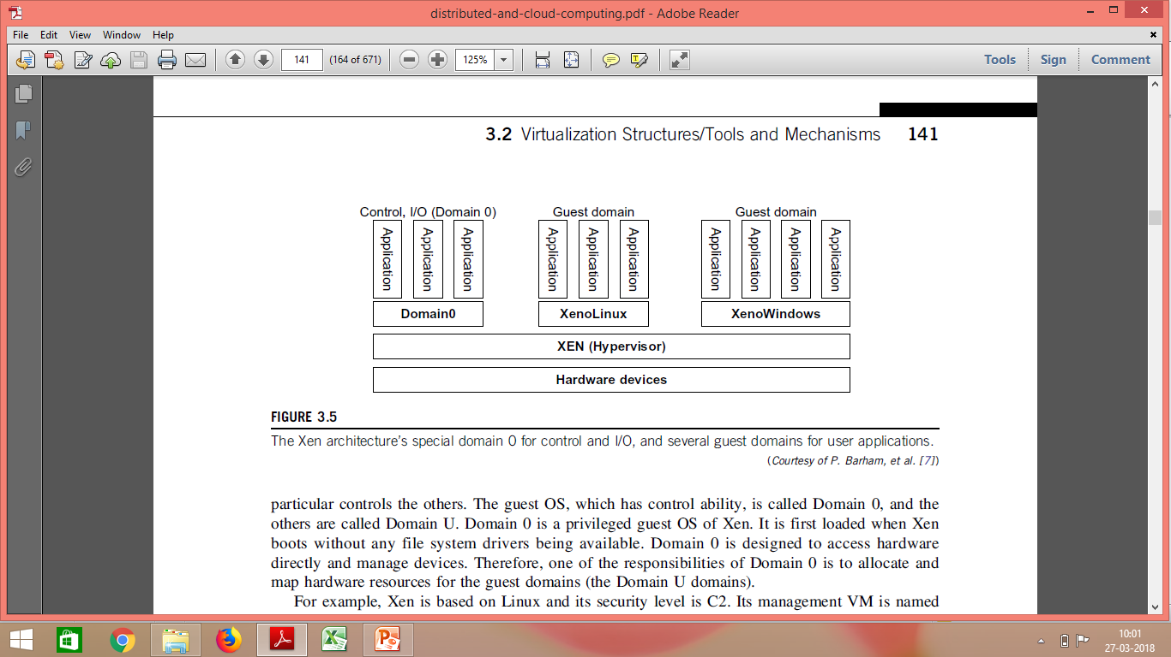
The Xen Architecture

Slide 127
The Xen Architecture
The core components of a Xen system are
the hypervisor
kernel,
applications.
The organization of the three components is important.

Slide 128
The Xen Architecture
Many guest OSes can run on top of the hypervisor.
Not all guest OSes are created equal, and
One in particular controls the others.

Slide 129
The Xen Architecture
The guest OS, which has control ability, is called Domain 0
The others are called Domain U.

Slide 130
What is a Domain?
Guest operating systems are executed within Domains which represent VMs instances.
They are of 2 types:
Domain O
Domain U

Slide 131
Domain 0
Specific Control Software
Controls all the other guest operating systems ,
is executed in a special domain called Domain 0.
Privileged guest OS of Xen
Privileged access to the host
Also called Management VM
As it has the privilege to manage other VMs implemented on the same host.

Slide 132
Domain 0
It is first loaded when Xen boots without any file system drivers being available.
Domain 0 is designed to access hardware directly and manage devices.
Therefore, one of the responsibilities of Domain 0 is to allocate and map hardware resources for the other guest domains(Domain U)

Slide 133
How does Domain 0 Work?
The first one that is loaded once the VMM has been completely booted.
It Hosts an HTTP server that serves requests for VM creation, configuration, migrate, suspension, resume and termination.
Domain 0, behaving as a VMM, allows users to create, copy, save, read, modify, share, migrate, and roll back VMs as easily as manipulating a file

Slide 134
Security of Domain 0
If Domain 0 is compromised, the hacker can control the entire system.
Security policies are needed to improve the security of Domain 0.
The Series of security problems during the software life cycle and data lifetime have to be handled.

Slide 135
Domain U
All the other domains running guest operating systems are called Domain U

Slide 136
HyperCalls
“The hypervisor provides hypercalls for the guest OSes and applications. “
Sensitive system calls need to be re-implemented with hypercalls.
The Xen hypervisor is able to catch the execution of all the sensitive instructions manage them and return the control to the guest operating system by means of a handler.

Slide 137
Full Virtualization with Binary Translation

Slide 138
Full Virtualization
With full virtualization, non-critical instructions run on the hardware directly while
critical instructions are discovered and replaced with traps into the VMM to be emulated by software.

Slide 139
Full Virtualization
Why are only critical instructions trapped into the VMM?
Non-critical instructions
do not control hardware or
do not threaten the security of the system, but critical instructions do.
Running noncritical instructions on hardware not only
can promote efficiency,
but also can ensure system security.

Slide 140
Full Virtualization: Why only CI?
FV relies on binary translation to trap and to virtualize the execution of certain sensitive, non-virtualizable instructions.

Slide 141
Popek and Goldberg Instructions
The Popek and Goldberg virtualization requirements are a set of conditions sufficient for a computer architecture to support system virtualization efficiently.
They were introduced by Gerald J. Popek and Robert P. Goldberg in their 1974 article "Formal Requirements for Virtualizable Third Generation Architectures".
A convenient way of determining whether a computer architecture supports efficient virtualization and provide guidelines for the design of virtualized computer architectures.

Slide 142
Popek and Goldberg Instructions
Privileged instructions
Those that trap if the processor is in user mode and do not trap if it is in system mode (supervisor mode).
Control sensitive instructions
Those that attempt to change the configuration of resources in the system.
Behavior sensitive instructions
Those whose behavior or result depends on the configuration of resources (the content of the relocation register or the processor's mode).

Slide 143
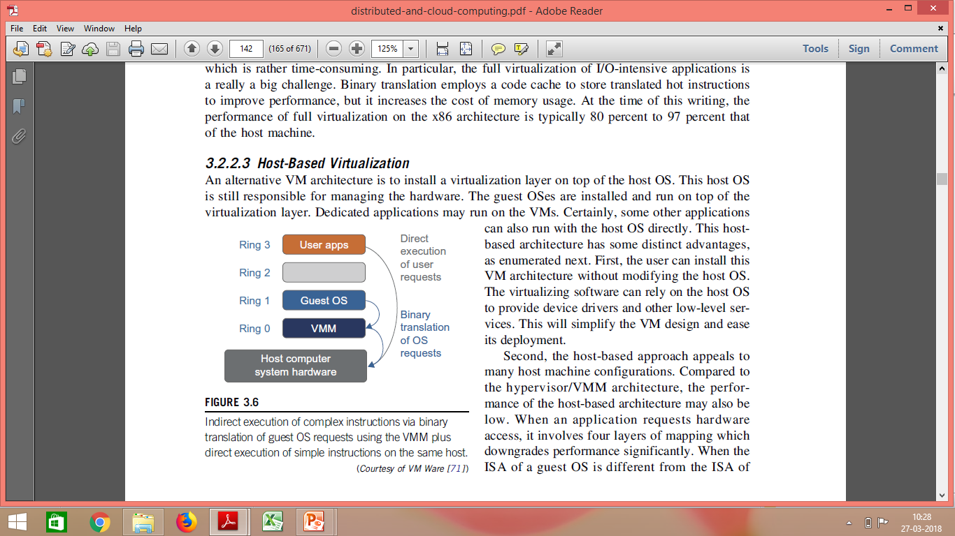
Binary Translation of Guest OS Requests Using a VMM
VMware puts the VMM at Ring 0 and the guest OS at Ring 1.
The VMM scans the instruction stream and identifies the privileged, control- and behavior-sensitive instructions.

Slide 144
Binary Translation of Guest OS Requests Using a VMM
They are trapped into the VMM, which emulates the behavior of these instructions.
The method used in this emulation is called binary translation.

Slide 145
Translation
The trap triggers the
translation of the offending instructions into
an equivalent set of instructions that achieve the same goal without generating exceptions.

Slide 146
Binary Translation of Guest OS Requests Using a VMM
Thus, full virtualization combines binary translation and direct execution.

Slide 147
Binary Translation of Guest OS Requests Using a VMM
The guest OS is completely decoupled from the underlying hardware.
The guest OS is unaware that it is being virtualized.

Slide 148
Full Virtualization
Full virtualization does not need to modify guest OS, and critical instructions are emulated by software through the use of binary translation.
Advantage –
No need to modify OS.
However, this approach of binary translation slows down the performance a lot.
Also binary translation can incur a large performance overhead.

Slide 149
Caching
Binary translation employs a code cache
To store translated hot instructions to improve performance,
To improve efficiency,
the equivalent set of instruction is cached,
so that for further occurrences of the same instructions, translation is not necessary anymore
But it increases the cost of memory usage.

Slide 150
Advantage ?
Disadvantage ?

Slide 151
Advantage
Guests can run unmodified in a virtualized environment.
Binary translation is only applied to a subset of the instruction set, while the others are managed through direct execution on the underlying hardware.
This reduces the impact on performance of binary translation

Slide 152
Disadvantage
Translating instructions at runtime introduces additional overhead that is not present in other approaches like para-virtualization and hardware assisted virtualization.
Rather time-consuming, In particular for the full virtualization of I/O-intensive applications.
The code cache to store translated hot instructions to improve performance, but it increases the cost of memory usage.

Slide 153
Example of FV

Slide 154
VMWARE
Full Virtualization.
Underlying Hardware is made available to the guest operating System which
runs unaware of such abstraction layer and
does not need to be modified.
Guest OS is VMM unaware

Slide 155
Para-Virtualization with Compiler Support

Slide 156
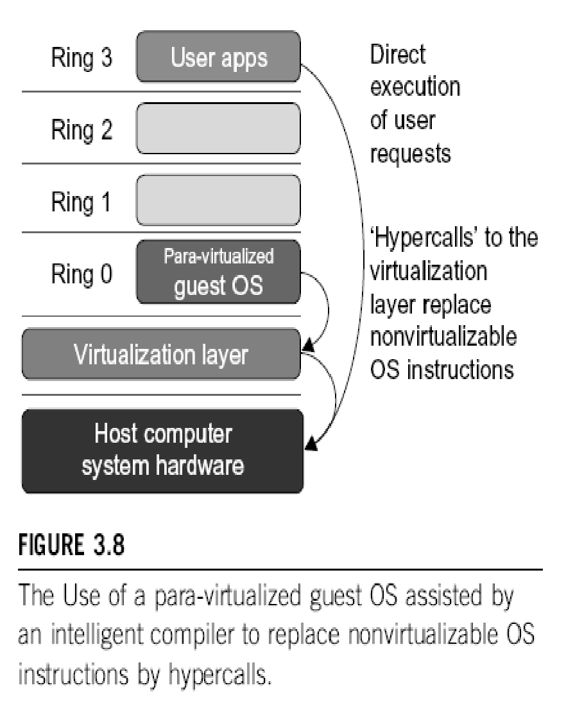
Para-Virtualization with Compiler Support
Para-virtualization needs to modify the guest operating systems.

Slide 157
Para-Virtualization with Compiler Support
A para-virtualized VM provides special APIs requiring substantial OS modifications in user applications.
However, when the guest OS kernel is modified for virtualization, it can no longer run on the hardware directly.

Slide 158
Performance Issue
Performance degradation is a critical issue of a virtualized system.
No one wants to use a VM if it is much slower than using a physical machine.
Para-virtualization attempts to reduce the virtualization overhead, and
thus improve performance by modifying only the guest OS kernel.

Slide 159
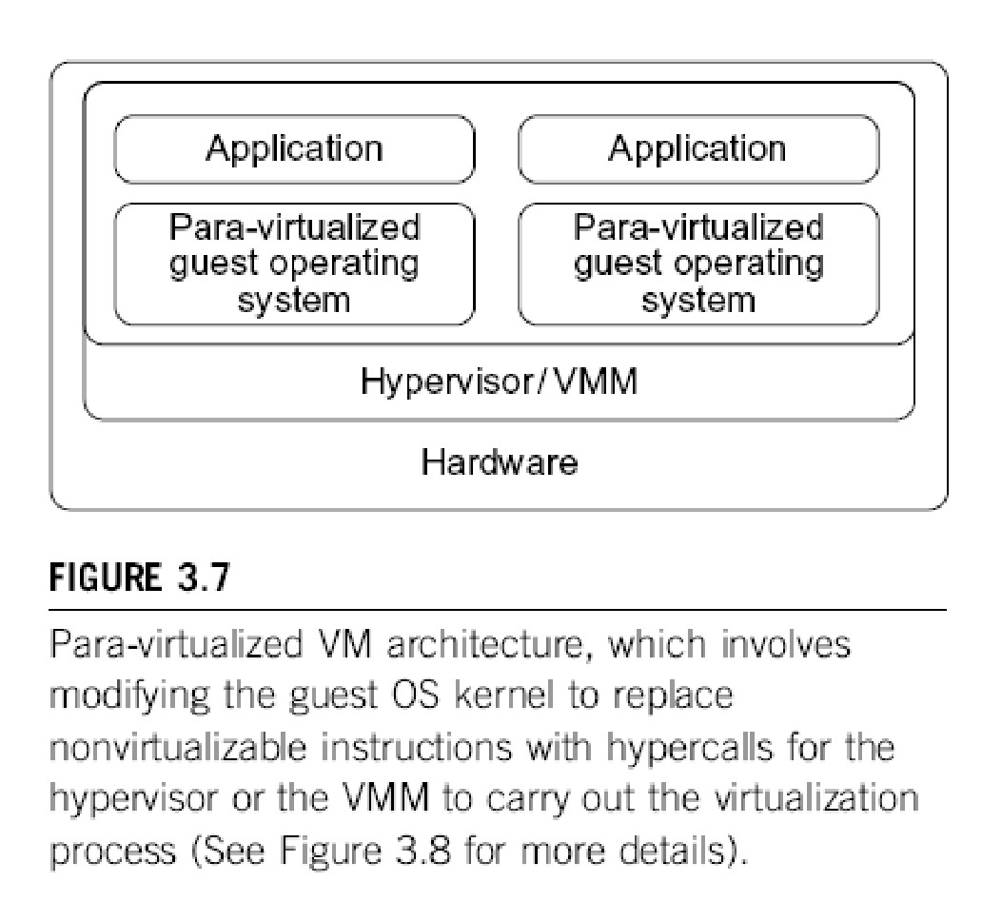
Para-Virtualization: Intelligent Compiler
The guest operating systems are para-virtualized.
They are assisted by an intelligent compiler to replace the non-virtualizable OS instructions by hypercalls that communicate directly with the hypervisor or VMM.

Slide 160
Hypercall
Like syscall is to a kernel.
Hypercall is to a hypervisor
A hypercall is a software trap from a domain to the hypervisor, just as a syscall is a software trap from an application to the kernel.
All are the same thing: a system call to the hypervisor below.
Such calls require support in the "guest" operating system, which has to have hypervisor-specific code to make such calls.

Slide 161
Full Virtualization vs. Para-Virtualization
Full virtualization does not need to modify guest OS, and critical instructions are emulated by software through the use of binary translation.
On the other hand, para virtualization needs to modify guest OS, and non-virtualizable instructions are replaced by hypercalls that communicate directly with the hypervisor or VMM.
Para-Virtualization with Compiler Support
WORK
I
NG

Slide 162
Full Virtualization vs. Para-Virtualization
As of full virtualization, the advantage is no need to modify OS. However, this approach of binary translation slows down the performance a lot.
Para virtualization, reduce the virtualization overhead, and improve performance but the cost of maintaining paravirtualized OS is high. The improvement depends on the workload.

Slide 163
Microsoft Hyper-V
Hyper-V is an infrastructure virtualization solution developed by Microsoft for server virtualization.
As the name recalls, it uses a hypervisor-based approach to hardware virtualization, which leverages several techniques to support a variety of guest operating systems.
Type 1 Hypervisor

Slide 164
Microsoft Hyper-V
Hyper-V is currently shipped as a component of Windows Server 2008 R2 that installs the hypervisor as a role within the server.

Slide 165
Eg-Selecting a server followed by OS in Microsoft Azure

Slide 166
Eg-Selecting a server followed by OS in Microsoft Azure

Slide 167
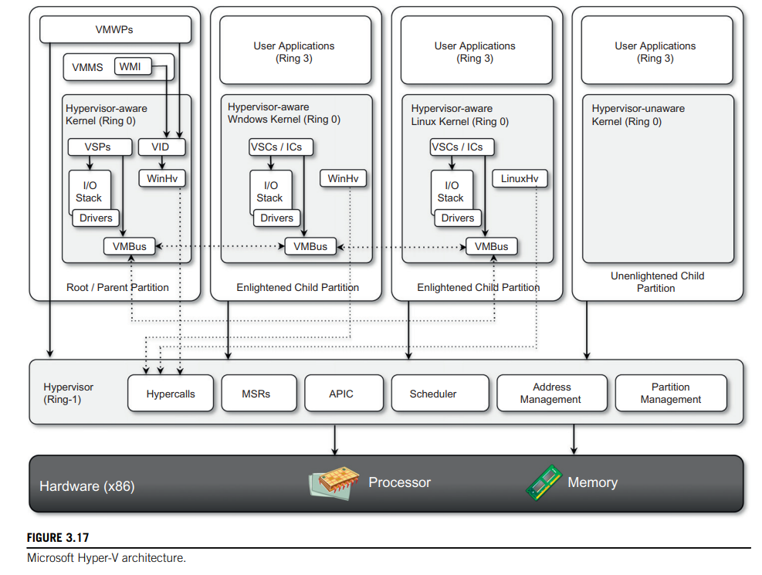
Architecture
Hyper-V supports multiple and concurrent execution of guest operating systems by means of partitions.
A partition is a completely isolated environment in which an operating system is installed and run
Figure provides an overview of the architecture of Hyper-V.

Slide 168
Architecture
Despite its straightforward installation as a component of the host operating system,
Hyper-V takes control of the hardware, and the host operating system becomes a virtual machine instance with special privileges, called the parent partition.

Slide 169
Architecture
The parent partition (also called the root partition)
Is the only one that has direct access to the hardware.
It runs the virtualization stack, hosts all the drivers required to configure guest operating systems, and creates child partitions through the hypervisor.

Slide 170
Architecture
Child partitions are used to host guest operating systems and do not have access to the underlying hardware,
but their interaction with it is controlled by either the parent partition or the hypervisor itself.

Slide 171
Microsoft Hyper-V Hypervisor
The hypervisor is the component that directly manages the underlying hardware (processors and memory).
It is logically defined by the following components:
Hypercalls interface-
Memory service routines (MSRs)-
Advanced programmable interrupt controller (APIC).
Scheduler-
Address manager-
Partition manager-

Slide 172
Microsoft Hyper-V Hypervisor
Hypercalls interface-
This is the entry point for all the partitions for the execution of sensitive instructions.
This is an implementation of the paravirtualization approach

Slide 173
Microsoft Hyper-V Hypervisor
Hypercalls interface-
This interface is used by drivers in the partitioned operating system to contact the hypervisor using the standard Windows calling convention.
The parent partition also uses this interface to create child partitions.

Slide 174
Microsoft Hyper-V Hypervisor
Memory service routines (MSRs)-
These are the set of functionalities that control the memory and its access from partitions.
By leveraging hardware-assisted virtualization, the hypervisor uses the Input/Output Memory Management Unit (I/O MMU or IOMMU) to fast-track access to devices from partitions by translating virtual memory addresses.

Slide 175
Microsoft Hyper-V Hypervisor
Scheduler-
This component schedules the virtual processors to run on available physical processors.
The scheduling is controlled by policies that are set by the parent partition.

Slide 176
Microsoft Hyper-V Hypervisor
Address manager-
This component is used to manage the virtual network addresses that are allocated to each guest operating system.

Slide 177
Microsoft Hyper-V Hypervisor
Partition manager-
This component is in charge of performing partition
creation,
finalization,
destruction,
enumeration, and
configurations.
Its services are available through the hypercalls interface API previously discussed.

Slide 178
Microsoft Hyper-V Hypervisor
Advanced programmable interrupt controller (APIC)-
This component represents the interrupt controller, which manages the signals coming from the underlying hardware when some event occurs
timer expired,
I/O ready,
exceptions and
traps

Slide 179
Microsoft Hyper-V Hypervisor
Advanced programmable interrupt controller (APIC)-
Each virtual processor is equipped with a synthetic interrupt controller (SynIC), which constitutes an extension of the local APIC.

Slide 180
Microsoft Hyper-V Hypervisor
Advanced programmable interrupt controller (APIC)-
The hypervisor is responsible of dispatching the physical interrupts to the synthetic interrupt controllers.
Its services are available through the hypercalls interface API previously discussed.

Slide 181
Microsoft Hyper-V Hypervisor
The hypervisor runs in Ring -1
Therefore requires corresponding hardware technology that enables such a condition.

Slide 182
Microsoft Hyper-V Hypervisor
By executing in this highly privileged mode, the hypervisor can support legacy operating systems that have been designed for x86 hardware.
Operating systems of newer generations can take advantage of the new specific architecture of Hyper-V especially for the I/O operations performed by child partitions

Slide 183
VMware
VMware is a pioneer in virtualization technology
VMware offers a collection of virtualization solutions covering the entire range of the market, from desktop computing to enterprise computing and infrastructure virtualization.

Slide 184
End-user (desktop) virtualization
VMware supports virtualization of operating system environments and single applications on enduser computers.
Specific VMware software—
VMware Workstation, for Windows operating systems, and
VMware Fusion, for Mac OS X environments—
Are installed in the host operating system to create virtual machines and manage their execution.

Slide 185
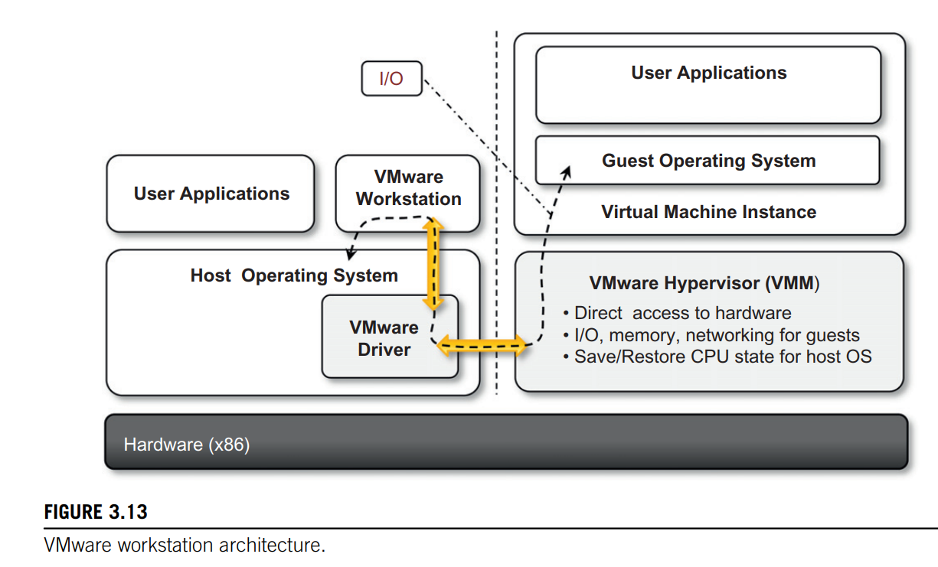
End-user (desktop) virtualization
Virtualization is done by installing a specific driver in the host operating system that provides two main services:
It deploys a virtual machine manager that can run in privileged mode.

Slide 186
End-user (desktop) virtualization
It provides hooks for the VMware application to process specific I/O requests eventually by relaying such requests to the host operating system via system calls.

Slide 187
Server virtualization
VMware provided solutions for server virtualization with different approaches over time.

Slide 188
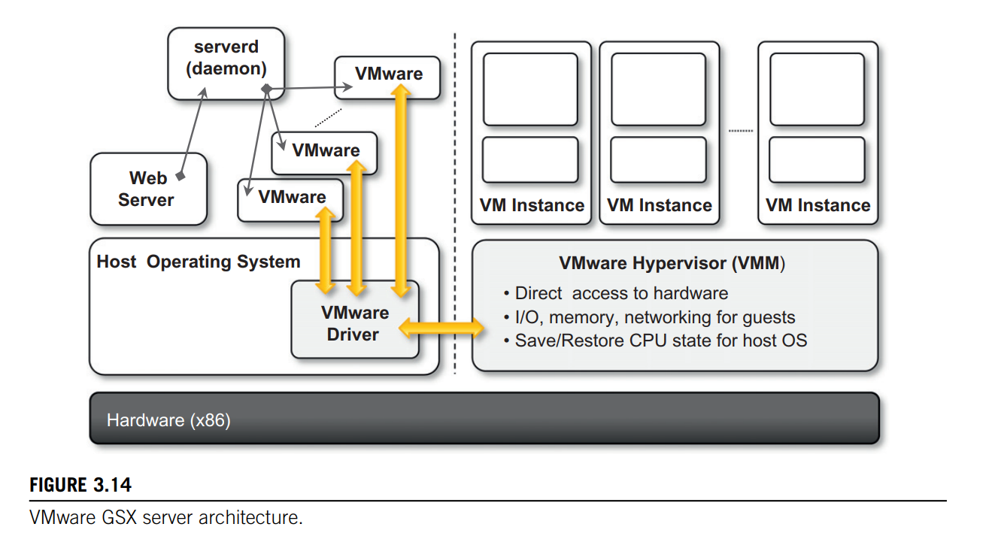
Server virtualization
Initial support for server virtualization was provided by VMware GSX server,
VMware GSX server which replicates the approach used for end-user computers and introduces remote management and scripting capabilities

Slide 189
Server virtualization
The architecture is mostly designed to serve the virtualization of Web servers.
A daemon process, called serverd, controls and manages VMware application processes.

Slide 190
Server virtualization
These applications are then connected to the virtual machine instances by means of the VMware driver installed on the host operating system.
Virtual machine instances are managed by the VMM as described previously.

Slide 191
Server virtualization
User requests for virtual machine management and provisioning are routed from the Web server through the VMM by means of serverd.

Slide 192
Server virtualization
VMware ESX Server and its enhanced version, VMWare ESXi Server, are examples of the hypervisor-based approach.
Both can be installed on bare metal servers and provide services for virtual machine management.
The two solutions provide the same services but differ in the internal architecture, more specifically in the organization of the hypervisor kernel.

Slide 193
Infrastructure virtualization and cloud computing solutions
VMware provides a set of products covering the entire stack of cloud computing,
from infrastructure management to Software-as-a-Service solutions hosted in the cloud.

Slide 194
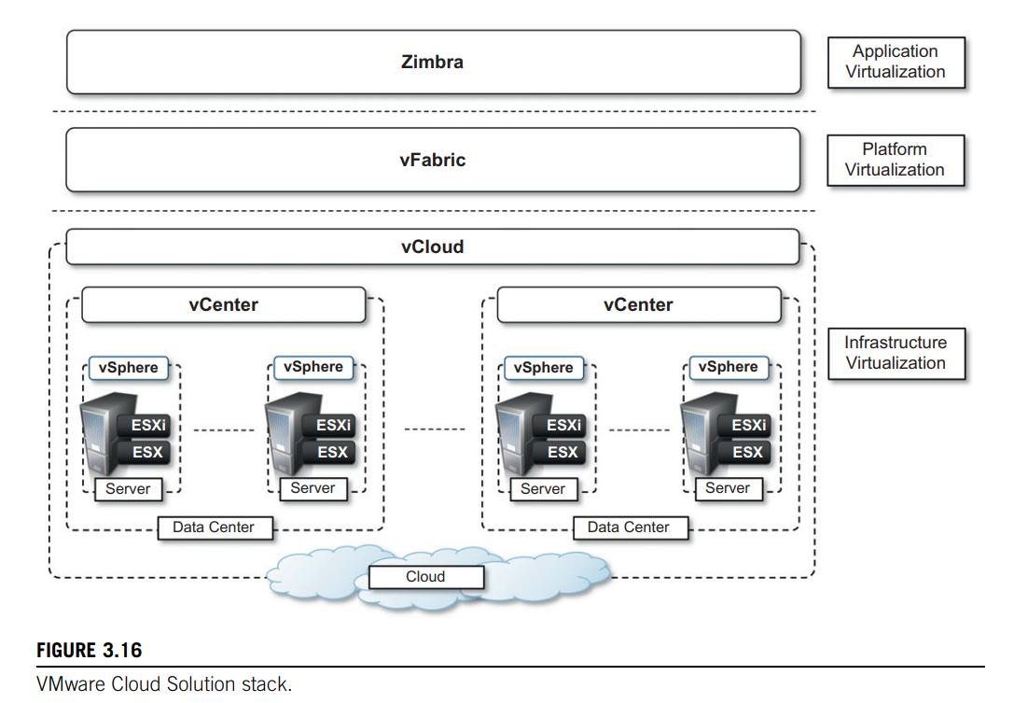
Infrastructure virtualization and cloud computing solutions
Figure 3.16 gives an overview of the different solutions offered and how they relate to each other.

Slide 195
Infrastructure virtualization and cloud computing solutions
ESX and ESXi constitute the building blocks of the solution for virtual infrastructure management:

Slide 196
Infrastructure virtualization and cloud computing solutions
A pool of virtualized servers is tied together and remotely managed as a whole by VMware vSphere.

Slide 197
Infrastructure virtualization and cloud computing solutions
vSphere-
As a virtualization platform it provides a set of basic services besides virtual compute services:
Virtual file system,
virtual storage, and
virtual network
constitute the core of the infrastructure;

Slide 198
Infrastructure virtualization and cloud computing solutions
application services, such as
virtual machine migration,
storage migration,
data recovery, and
security zones, complete the services offered by vSphere.

Slide 199
Infrastructure virtualization and cloud computing solutions
The management of the infrastructure is operated by VMware vCenter,
which provides centralized administration and management of vSphere installations in a data center environment

Slide 200
Infrastructure virtualization and cloud computing solutions
A collection of virtualized data centers are turned into a Infrastructure-as-a-Service cloud by VMware vCloud,
which allows service providers to make available to end users virtual computing environments on demand on a pay-per-use basis.
IAAS

Slide 201
Infrastructure virtualization and cloud computing solutions
A Web portal provides access to the provisioning services of vCloud, and end users can self provision virtual machines by choosing from available templates and setting up virtual networks among virtual instances.

Slide 202
Infrastructure virtualization and cloud computing solutions
VMware also provides a solution for application development in the cloud with VMware vFabric,
vFabric is a set of components that facilitate the development of scalable Web applications on top of a virtualized infrastructure
PAAS

Slide 203
Infrastructure virtualization and cloud computing solutions
vFabric is a collection of components for application monitoring, scalable data management, and scalable execution and provisioning of Java Web applications

Slide 204
Infrastructure virtualization and cloud computing solutions
Finally, at the top of the cloud computing stack, VMware provides Zimbra, a solution for office automation, messaging, and collaboration that is completely hosted in the cloud and accessible from anywhere.
SaaS

Slide 205
Infrastructure virtualization and cloud computing solutions
Zimbra is an SaaS solution that integrates various features into a single software platform providing email and collaboration management.

Slide 206
The cloud reference model
Cloud computing supports any IT service that can be consumed as a utility and delivered through a network, most likely the Internet.
Such characterization includes quite different aspects: infrastructure, development platforms, application and services.

Slide 207
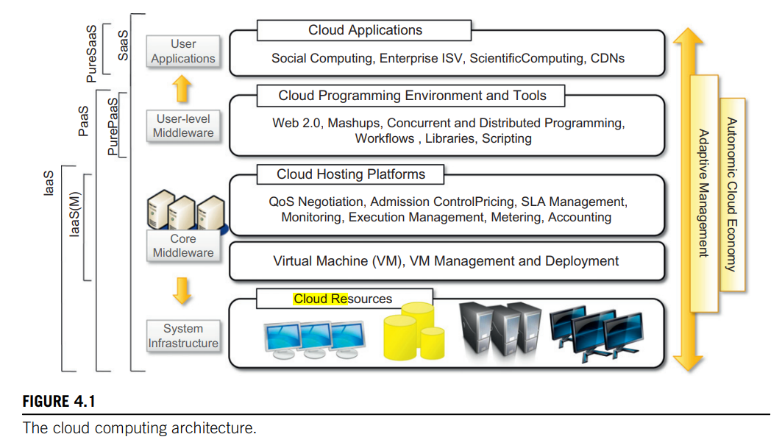
Architecture
It is possible to organize all the concrete realizations of cloud computing into a layered view covering the entire stack from hardware appliances to software systems.

Slide 208
The cloud reference model
Cloud resources -are harnessed to offer “computing horsepower” required for providing services.
Often, this layer is implemented using a datacenter in which hundreds and thousands of nodes are stacked together.

Slide 209
The cloud reference model
Cloud infrastructure can be heterogeneous in nature because a variety of resources, such as clusters and even networked PCs, can be used to build it.
Moreover, database systems and other storage services can also be part of the infrastructure

Slide 210
The cloud reference model
The physical infrastructure is managed by the core middleware,
The objectives of which are to provide an appropriate runtime environment for applications and to best utilize resources

Slide 211
The cloud reference model
Core Middleware-
At the bottom of the stack, virtualization technologies are used to guarantee runtime environment customization, application isolation, sandboxing, and quality of service.
Hypervisors manage the pool of resources and expose the distributed infrastructure as a collection of virtual machines.

Slide 212
The cloud reference model
The combination of cloud hosting platforms and resources is generally classified as a Infrastructure-as-a-Service (IaaS) solution.

Slide 213
The cloud reference model
We can organize the different examples of IaaS into two categories:
Some of them provide both the management layer and the physical infrastructure;
others provide only the management layer (IaaS (M)).

Slide 214
The cloud reference model
In this second case, the management layer is often integrated with other IaaS solutions that provide physical infrastructure and adds value to them.

Slide 215
The cloud reference model
A new layer is formed by cloud programming environments and tools, for offering users a development platform for applications.
The range of tools include Web-based interfaces, command-line tools, and frameworks for concurrent and distributed programming.

Slide 216
The cloud reference model
Platform-as-a-Service (PaaS) because the service offered to the user is a development platform rather than an infrastructure.
PaaS solutions generally include the infrastructure as well, which is bundled as part of the service provided to users.
In the case of Pure PaaS, only the user-level middleware is offered, and it has to be complemented with a virtual or physical infrastructure.

Slide 217
The cloud reference model
The top layer of the reference model depicted in Figure contains services delivered at the application level.
These are mostly referred to as Software-as-a-Service (SaaS). In most cases these are Web-based applications that rely on the cloud to provide service to end users.

Slide 218
Economics of the cloud
The main drivers of cloud computing are economy of scale and simplicity of software delivery and its operation.
In fact, the biggest benefit of this phenomenon is financial: The pay-as-you-go model offered by cloud providers.

Slide 219
Economics of the cloud
In particular, cloud computing allows:
Reducing the capital costs associated to the IT infrastructure
Eliminating the depreciation or lifetime costs associated with IT capital assets
Replacing software licensing with subscriptions
Cutting the maintenance and administrative costs of IT resources

Slide 220
Capital Costs
A capital cost is the cost occurred in purchasing an asset that is useful in the production of goods or the rendering of services.
Capital costs are one-time expenses that are generally paid up front and that will contribute over the long term to generate profit.
The IT infrastructure and the software are capital assets because enterprises require them to conduct their business.

Slide 221
Capital Costs
At present it does not matter whether the principal business of an enterprise is related to IT,
because the business will definitely have an IT department that is used to automate many of the activities that are performed within the enterprise:
payroll,
customer relationship management,
enterprise resource planning,
tracking and inventory of products, and others.
Hence, IT resources constitute a capital cost for any kind of enterprise .

Slide 222
Capital Costs
It is good practice to try to keep capital costs as low as possible
As capital costs are associated with material things they are subject to depreciation over time,
which in the end reduces the profit of the enterprise because such costs are directly subtracted from the enterprise revenues.

Slide 223
Capital Costs
In the case of IT capital costs, the depreciation costs are represented
by the loss of value of the hardware over time and
the aging of software products that need to be replaced because new features are required.

Slide 224
Before cloud computing diffused within the enterprise, the budget spent on IT infrastructure and software constituted a significant expense for medium-sized and large enterprises
Many enterprises owned a small or medium-sized datacenter that introduces several operational costs in terms of maintenance, electricity, and cooling.
Additional operational costs are occurred in maintaining an IT department and an IT support center.
Moreover, other costs are triggered by the purchase of potentially expensive software.

Slide 225
With cloud computing these costs are significantly reduced or simply disappear according to its penetration.

Slide 226
Capital Costs
In terms of the pricing models introduced by cloud computing, we can distinguish three different strategies that are adopted by the providers:
Tiered pricing
Per-unit pricing
Subscription-based pricing

Slide 227
Tiered pricing-
In this model, cloud services are offered in several tiers,
Each of which offers a fixed computing specification and SLA at a specific price per unit of time.
This model is used by Amazon for pricing the EC2 service, which makes available different server configurations in terms of computing capacity (CPU type and speed, memory) that have different costs per hour.

Slide 228
Per-unit pricing-
This model is more suitable to cases where the principal source of revenue for the cloud provider is determined in terms of units of specific services, such as data transfer and memory allocation.
In this scenario customers can configure their systems more efficiently according to the application needs.
This model is used, for example, by GoGrid, which makes customers pay according to RAM/hour units for the servers deployed in the GoGrid cloud.

Slide 229
Subscription-based pricing-
This is the model used mostly by SaaS providers in which users pay a periodic subscription fee for use of the software or the specific component services that are integrated in their applications

Slide 230
Open challenges
Still in its infancy, cloud computing presents many challenges for industry and academia.

Slide 231
Open challenges
Still in its infancy, cloud computing presents many challenges for industry and academia:-
Cloud definition
Cloud interoperability and standards
Scalability and fault tolerance
Security, trust, and privacy
Organizational aspects

Slide 232
Cloud definition
There have been several attempts made to define cloud computing and

Slide 233
Cloud definition
One of the most comprehensive formalizations is noted in the NIST working definition of cloud computing .
It characterizes cloud computing as on-demand self-service, broad network access, resource-pooling, rapid elasticity, and measured service; classifies services as SaaS, PaaS, and IaaS; and categorizes deployment models as public, private, community, and hybrid clouds.
The view is shared by many IT practitioners and academics.

Slide 234
Cloud definition
Despite the general agreement on the NIST definition, there are alternative taxonomies for cloud services.
David Linthicum, founder of BlueMountains Labs, provides a more detailed classification, which comprehends 10 different classes and better suits the vision of cloud computing within the enterprise.

Slide 235
Cloud definition
A different approach has been taken at the University of California, Santa Barbara (UCSB), which departs from the XaaS concept and tries to define an ontology for cloud computing.

Slide 236
Cloud definition
In their work the concept of a cloud is dissected into five main layers:
applications,
software environments,
software infrastructure,
software kernel, and
hardware.
Each layer addresses the needs of a different class of users within the cloud computing community and most likely builds on the underlying layers

Slide 237
Cloud interoperability and standards
Introducing standards and allowing interoperability between solutions offered by different vendors are objectives of fundamental importance.
Vendor lock-in constitutes one of the major strategic barriers against the seamless adoption of cloud computing at all stages.

Slide 238
Cloud interoperability and standards
Vendor lock-in can prevent a customer from switching to another competitor’s solution, or
when this is possible, it happens at considerable conversion cost and requires significant amounts of time.
This can occur either because the customer wants to find a more suitable solution for customer needs or because the vendor is no longer able to provide the required service

Slide 239
Cloud interoperability and standards
The current state of standards and interoperability in cloud computing resembles the early Internet era,
when there was no common agreement on the protocols and technologies used and each organization had its own network.

Slide 240
Cloud interoperability and standards
Yet the first steps toward a standardization process have been made, and a few organizations, such as the
Cloud Computing Interoperability Forum (CCIF),
Open Cloud Consortium, and
DMTF Cloud Standards Incubator,
are leading the path.

Slide 241
Scalability and fault tolerance
The ability to scale on demand constitutes one of the most attractive features of cloud computing. Clouds allow scaling beyond the limits of the existing in-house IT resources, whether they are infrastructure (compute and storage) or applications services.
To implement such a capability, the cloud middleware has to be designed with the principle of scalability along different dimensions in mind—for example, performance, size, and load.
The cloud middleware manages a huge number of resource and users, which rely on the cloud to obtain the horsepower that they cannot obtain within the premises without bearing considerable administrative and maintenance costs

Slide 242
Security, trust, and privacy
Security, trust, and privacy issues are major obstacles for massive adoption of cloud computing.
The traditional cryptographic technologies are used to prevent data tampering and access to sensitive information.
The massive use of virtualization technologies exposes the existing system to new threats, which previously were not considered applicable.

Slide 243
Security, trust, and privacy
On one side we need to decide whether to trust the provider itself;
On the other side, specific regulations can simply prevail over the agreement the provider is willing to establish with us concerning the privacy of the information managed on our behalf.
Moreover, cloud services delivered to the end user can be the result of a complex stack of services that are obtained by third parties via the primary cloud service provider.

Slide 244
Security, trust, and privacy
In this case there is a chain of responsibilities in terms of service delivery that can introduce more vulnerability for the secure management of data, the enforcement of privacy rules, and the trust given to the service provider.
In particular, when a violation of privacy or illegal access to sensitive information is detected, it could become difficult to identify who is liable for such violations.

Slide 245
Organizational aspects
Cloud computing introduces a significant change in the way IT services are consumed and managed.
More precisely, storage, compute power, network infrastructure, and applications are delivered as metered services over the Internet.
This introduces a billing model that is new within typical enterprise IT departments, which requires a certain level of cultural and organizational process maturity.
In particular, a wide acceptance of cloud computing will require a significant change to business processes and organizational boundaries

Slide 246
Organizational aspects
In particular, the following questions have to be considered:
What is the new role of the IT department in an enterprise that completely or significantly relies on the cloud?
How will the compliance department perform its activity when there is a considerable lack of control over application
What are the implications (political, legal, etc.) for organizations that lose control over some aspects of their services?
What will be the perception of the end users of such services workflows?

